Slide 1
EIT TALLINN DIGITAL ACADEMY Summer School
Introduction to I&E project work
Prof. Taina Tukiainen
Summer 2018

Slide 2
Summer Schools are an integral part of the EIT Digital Master School I&E education
The Summer School has specific pedagogical objectives, complementary to the 1st year I&E education
The Summer School is an intensive 2 weeks ‘sprint’ project
It brings you together to work in groups on a business modelling and planning project in the context of an industry thematic area
In addition, it aims at fostering a community of students among your various universities and at creating interaction with companies, entrepreneurs, industry professionals and experts
The I&E Summer School course is 4 ects, meaning around 110 hours of work for you

Slide 3
Prerequisites and assumptions
We assume you have successfully completed the Summer School Online Starter Kit
We assume you work in the evenings and over the weekend

Slide 4
Summer School I&E education
Principles
Based on a 2 weeks project work by teams of 4-5 students
Preceded by an online Starter Kit covering I&E pre-requisites
Project based on cases provided by EIT Digital partners
Project covering product/service design, business modelling and planning
Pitch on your business model at the end of 1st week
Final pitch on your business plan in front of a jury at the end of 2nd week
Written report submitted within 2 weeks after the Summer School
Grading on the final pitch (50%) and on the written report (50%)

Slide 5
Summer School I&E education
Intended learning objectives
BDLab
SSchools
Generic I&E
Creativity, Ideation
Product/service design
Business development (BM, BP)
Assess the impact of Digital technologies
Exploit technologies (IPR…)
Value judgment and sustainability
Communication, leadership, decision making
Introduce & apply creativity techniques
Introduce & apply
Apply in thematic area
Intro. (& apply) specific contents
Introduce & apply
Apply in thematic area
Intro. (& apply) specific contents
EIT, EIT Digital flavou-red I&E
(not covered)
Introduce & apply in thematic area
Introduce & apply
Apply in thematic area
Intro. (& apply) specific contents
Introduce & apply
Apply in thematic area
Intro. (& apply) specific contents
Soft skills
Oral + written communication; Experiential and experimental personal growth process; Strategic thinking
Oral + written communication; Tactical thinking; Fast decision making under time pressure

Slide 6
Summer School I&E education
Approach
2 weeks project to cover
1st week: concept design, business modelling
2nd week: business planning
Balanced time-share between
Applied lectures, testimonials, interaction with entrepreneurs, professionals and experts
Application and reflection within their project (with coaching)
Field work and data collection

Slide 7
Summer School I&E education
Program
1 Month before: * Online Starter Kit (pre-assignment)
Before
First 2 days: * Feedbacks to students on online Starter Kit
* Crash course to students on Starter Kit topics (optional)
* Presentation of project work and assessment criteria
* Presentation of cases and team building
Week: * Project work on concept & business model (thematic issues, user requirements, impact of tech, value networks, ethics, sustain.) // lectures, visits, field work, coaching,…
Last day: * Pitch on business model, on stage
Week 1
Week: * Project work on business plan (marketing, start-up strategy)
// lectures, visits, field work, coaching,…
Last day: * Pitch on business plan, on stage in front of jury (‘investor pitch’)
* Business panel jury feedbacks on students pitch
* Students answer Summer School evaluation questionnaire
* Prizes award
Week 2
Within 2 weeks: * Students written report
After

Slide 8
Assessment
As the I&E summer school course is a regular course, it is graded
Your projects are graded on two aspects (50% of the score each):
The business proposal as presented (pitch) in front of a business panel (2 - 3 independent company representatives, business consultants, entrepreneurs, complemented with EIT Digital representatives, the local I&E coordinator, and coaches)
AND a written report (mandatory), submitted WITHIN TWO WEEKS after the summer school

Slide 9
Assessment
The pitching exercise mimics a presentation to a panel of investors. The business panel should primarily judge the quality and feasibility of the business proposal (“will it fly”).
The grade is a group grade
The written report should document the project work, the motivations for taking certain directions and decisions, and the team process, including student own contribution. The report is graded by the local I&E coordinator (and if available by the business coach(es) and company supervisors).
The report can be submitted as a team report or as an individual report. In any case, individual deviations for the final grade compared to the group grading are allowed
A report template will be provided to you, please use it! It will also guide you in your project work

Slide 10
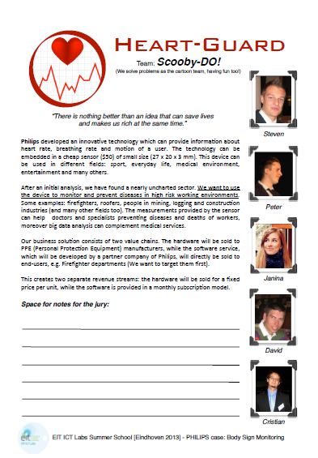
Team sheet & pitch presentation
Help business panel, please prepare an A4 team sheet with:
Name of project group – team
Members of the team with photo’s
Title of the business idea / proposal
Summary of the proposal (250 words)
Pitch presentation:
7 minutes + 3 Q/A, 7 – 14 slides
“sell idea to VC” i.e. specify how much money you need

Slide 11
Pitch and written report EIT General evaluation criteria
Creativity: Invents or finds solutions to address and solve his/her project main challenges (customer problem, functionality, business model, development,…)
Innovation: Drives his project according to the dimensions of (1) customer problem/solution discovery (including in relation to the product technical development) and (2) market discovery (related to strategic thinking) in ways that are relevant for the situation.
Entrepreneurship: Addresses key steps in a BM/BP/BD project/activity. Plans / diagnoses / recommendations or actions are well supported and appropriate. Identifies appropriate strategies for risk reduction.
Leadership: Description of the decision-making is detailed, objective and provides evidence of how leadership practice could be applied. Shows ability to achieve milestones, do problem solving, understand team roles, handle conflicts, negotiate, interact with stakeholders.
Making value judgments and sustainability: Ability to apply ethical perspectives in relation to his projects and to identify and assess future consequences of these in different situations and/or for different societal groups from a sustainability perspective. OR: Ability to relate the value proposed in his projects to all relevant stakeholders: producers, customers, shareholders, communities, ecological systems and policies

Slide 12
Specific pitch evaluation criteria
A) Overall proposed solution ___ / 20 %
Understanding of user’s need and market
Degree of innovation in the proposed solution
Coherence problem/solution and feasibility
B) Business model and plan ___ / 20 %
The feasibility and quality of the business model covering main ‘boxes’ of the BMG canvas
The market potential of the proposed venture
The go-to-market / market access approach
The financial and/or social return of the proposed venture
Strategy for gaining funding
Contingency planning and risk assessment
C) Presentation; quality of Q-A __/ 10 %
Delivers the pitch with passion, heart and enthusiasm. Grabs your attention with a hook/interesting opener
The quality of the team members’ responses to questions from the judges

Slide 13
Specific written report evaluation criteria
A) Business model and plan ____ / 20 %
Explains the need/niche that their product/service will fill
Explains the benefit/competitive advantage of the product or service
B) Business development process ___ / 20 %
Explains the entire process how the group came up with the proposed solution and the business plan; both contents wise and with respect to the process.
Learning experience: what did you learn? Contents and process wise?
What did you miss with respect to your own competences?
C ) Quality of report ___/ 10 %
Quality of report

